Slide 1
A Heuristic with Worst-case Analysis for Minimax Routing of Two Travelling Salesmen on a Tree
Igor Averbakh, Oded Berman
Discrete Applied Mathematics 68 (1996), pp. 17-32
Presenter : Hsiang-Yi Weng
Date : August 6, 2008

Slide 2
Abstract (1/2)
Suppose two travelling salesmen must visit together
all points/nodes of a tree, and the objective is to
minimize the maximal length of their tours. Home
locations of the salesmen are given, and it is
required to find optimal tours. For this NP-hard
problem a heuristic with complexity O(n) is
presented.

Slide 3

Abstract (2/2)
The worst-case relative error for the heuristic
performance is for the case of equal home
locations for both servers.

Slide 4
Example
100
50
Home
1
1
201
100
100
100
50
50
50
Home
Home
50
Home
1
100
1
1
1
1
1
50
50
50
100
100
100
100
50
Home
1
1
152
50
100

Slide 5
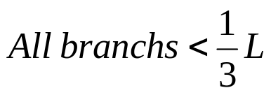
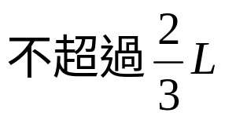
A 4/3-optimal heuristic for the case of a single home location
3
3
1
1
2
2
3
3
A
A
2
2
2
2
1
1
3
3

Slide 6
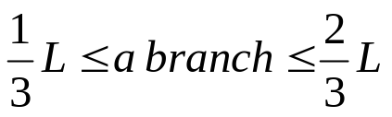
A 4/3-optimal heuristic for the case of a single home location
2
2
3
3
3
3
2
2
1
1
1
1
A
A
2
2
3
3
1
1

Slide 7
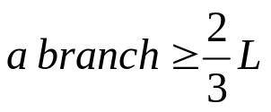

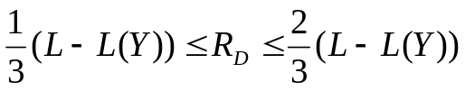
A 4/3-optimal heuristic for the case of a single home location
2
2
3
3
1
1
3
2
A
1
2
D
C
1
2
3
1
B
2
2
E
1
3
3
2
1
3

Slide 8
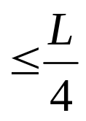
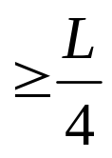
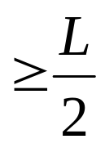
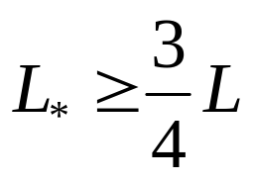
A 4/3-optimal heuristic for the case of a single home location

Slide 9
Conclusions and future research
A linear-time heuristic for the (NP-complete)
allocation minimax 2-TSP on a tree.
The worst-case relative error for the heuristic
performance is for the case of equal home
locations for both servers.

